Slide 1
Computer System Architecture Arun Singh Bhadwal Assistant Professor SoCS

Slide 2
Introduction
A 'computer generation' refers to a distinct period of technological improvement in the history of computing, during which certain types of hardware and software became dominant.
Across these generations, we observe significant changes in hardware - from vacuum tubes to transistors, from integrated circuits to microprocessors - and software, resulting in improved speed, reduced size, enhanced functionality, and decreased power consumption.
Understanding these changes helps us appreciate the advancements in the field of computer science and provides a lens through which to view the possible directions of future developments.

Slide 3
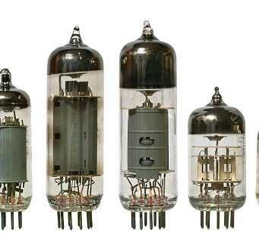
First Generation (1940-1956): Vacuum Tubes
The first generation of computers, dating from around 1940 to 1956, was marked by the use of vacuum tubes.
These machines were quite large, often taking up entire rooms, and they consumed massive amounts of electricity. They relied on machine language for programming, which made them somewhat inflexible and difficult to use.
A significant downside of vacuum tube computers was the intense heat they produced, which often led to failures and malfunctions. Their short lifespan and high maintenance requirements made them less efficient.
Despite these challenges, several important computers from this era made a significant impact. The ENIAC (Electronic Numerical Integrator and Computer), for example, was one of the most famous vacuum tube computers, utilized for complex military calculations during World War II.

Slide 4
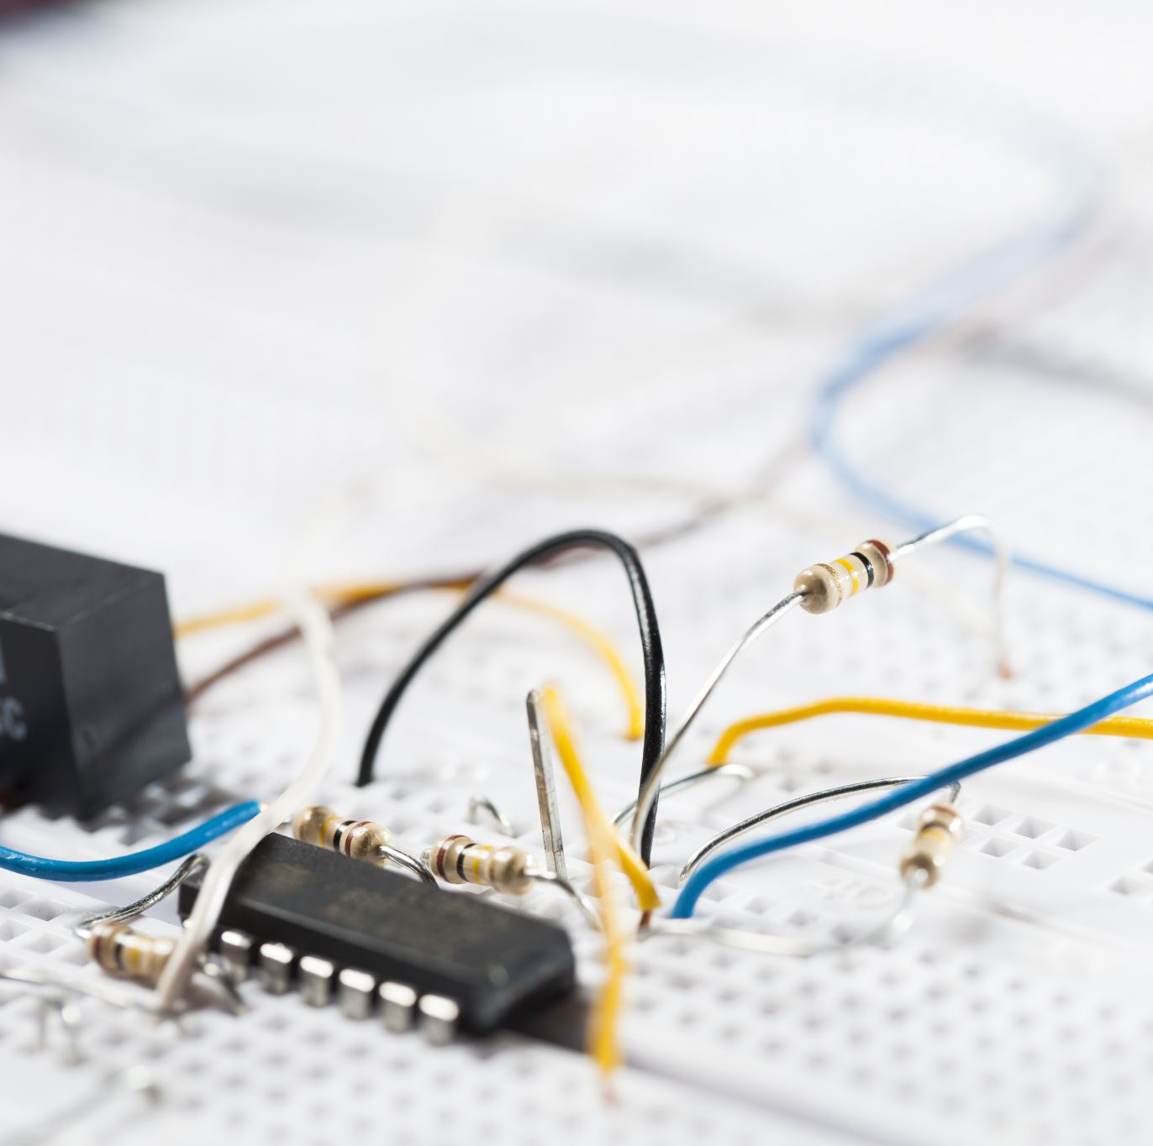
Second Generation (1956-1963): Transistors
The second generation of computers, spanning from 1956 to 1963, was marked by the replacement of vacuum tubes with transistors.
Transistors, being smaller and more energy-efficient than vacuum tubes, allowed computers to become more compact and reliable. They also produced less heat, which helped address one of the major problems of the first generation.
This era also saw the introduction of higher-level programming languages like FORTRAN and COBOL, making the systems more flexible and user-friendly.
The second generation saw improvements in size, speed, reliability, and user accessibility. However, transistors still had limitations, prompting the development of integrated circuits, marking the transition to the third generation.

Slide 5
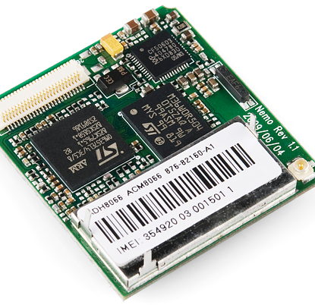
Third Generation (1964-1971): Integrated Circuits
The third generation of computers, ranging from 1964 to 1971, was characterized by the development and application of integrated circuits (ICs).
ICs, which miniaturized and combined multiple transistors, allowed for even smaller, faster, and more reliable computers. They also significantly reduced power consumption, which made these machines more practical for a wider range of applications.
In terms of software, the third generation saw advancements like time-sharing, real-time systems, and the early stages of the graphical user interface.
Notable computers of this generation include the IBM System/360, the first full family of compatible computers that could handle both commercial and scientific applications.
With the advent of integrated circuits and more versatile hardware and software, computers began to become a more common feature in businesses and institutions. However, the next big leap forward would come with the invention of the microprocessor, leading to the fourth generation of computers.

Slide 6
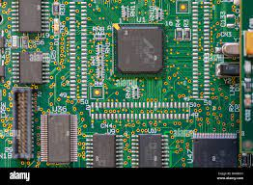
Fourth Generation (1971-Present): Microprocessors
The fourth generation of computers, starting from 1971 and continuing to the present day, is distinguished by the advent of microprocessors.
Microprocessors, which contain thousands of integrated circuits on a single silicon chip, were a game changer in computer technology. This compactness led to the creation of even smaller and more powerful computers.
The reduction in size and cost along with the increase in processing power gave birth to the era of personal computers. These machines could fit on a desk, were affordable to many, and offered capabilities that made them useful for both personal and business purposes.
The fourth generation has also been marked by major software developments, including a variety of user-friendly high-level programming languages, operating systems, and software applications. It's also in this generation that the Internet became widely available, transforming the way we use computers.
Notable examples from this generation include the Intel 4004, the first commercial microprocessor, and the Apple II, one of the first highly successful mass-produced personal computers.

Slide 7
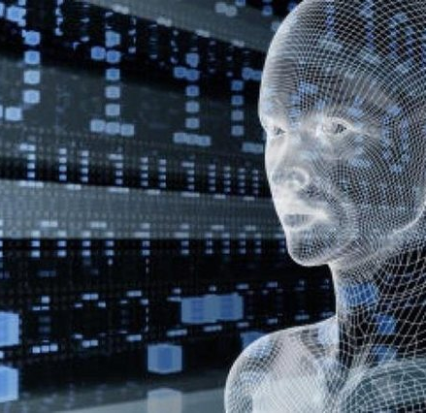
Fifth Generation (Present and Beyond): Artificial Intelligence
The fifth generation of computers, from the present and into the future, is characterized by computers with artificial intelligence (AI) and quantum computing capabilities.
This generation of computers is defined by the development and implementation of AI, allowing computers to learn, reason, and make decisions. Additionally, the rise of quantum computing promises significant advancements in processing power and speed.
AI enables computers to perform tasks that usually require human intelligence, such as recognizing patterns, learning from experience, and making decisions. Machine learning, a subset of AI, is a method of data analysis that automates the building of analytical models.
Notable AI systems include IBM Watson, which has been applied in fields ranging from healthcare to finance, and Google's AlphaGo, which defeated a world champion in the complex game of Go.
The fifth generation is about pushing the boundaries of what computers can do, harnessing the power of AI and potentially quantum computing to solve complex problems, make predictions, and automate tasks in ways we've only just begun to explore.

Slide 8
Key Technology |  | Size | Speed | Power Consumption | Programming | Notable Examples
Generation | Size | Speed | Power Consumption | Reliability | User Interface | Programming
1st (1940-1956) | Large | Slow | Very High | Low | Machine Language | Machine Code
2nd (1956-1963) | Medium | Moderate | High | Moderate | Text-based | Assembly and Early High-level Languages (FORTRAN, COBOL)
3rd (1964-1971) | Small | Fast | Medium | High | Text-based with early GUIs | High-Level Languages
4th (1971-now) | Very Small | Very Fast | Low | Very High | GUI, Voice Recognition | High-Level Languages, OOP
5th (Now->) | Variable | Extremely Fast | Variable | Very High | AI, GUI, Voice Recognition | AI, Machine Learning

Slide 9
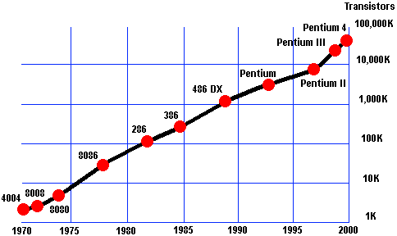
Moore's Law
Moore's Law is a prediction made by Gordon Moore in 1965. He stated that the number of transistors on a microchip would double approximately every two years, while the cost of computers would be halved.
Moore's Law has driven constant progress in the density and speed of integrated circuits, leading to technological advancements and reduced costs in computing.
Moore initially noticed that the number of transistors per square inch on integrated circuits had doubled every year since their invention.
Moore predicted that this trend would continue for the foreseeable future.

Slide 10
Limitations of Moore's Law
As technology improves, the scale of transistor shrinkage is reaching physical limits. Transistors can't be shrunk indefinitely.
The costs of chip production and design are increasing, challenging the economic feasibility of Moore's Law.

Slide 11
The Future of Moore's Law
There's ongoing debate about whether Moore's Law will continue to hold true. Some believe innovation will allow it to persist, while others believe we're rapidly approaching its end.
Alternatives to traditional computing, such as quantum computing, could potentially continue the trend of increasing computational power beyond the limits of Moore's Law.

Slide 12
Conclusion
Regardless of its future, Moore's Law has had a profound impact on the development of technology over the past half-century
Moore's Law is a testament to human innovation and the extraordinary growth of the technology sector.

Slide 13
Introduction to Von Neumann Architecture
Named after mathematician and physicist John von Neumann, the Von Neumann Architecture is a model for designing and building digital computers that use a single storage structure to hold both the set of instructions on how to perform the computation and the data required or generated by the computation.
"It consists of four main parts: the Arithmetic Logic Unit (ALU), control unit, memory, and input and output devices (I/O).
Virtually all modern computers are based on this architecture. It is foundational to understanding how computers function at a fundamental level.

Slide 14
Components of Von Neumann Architecture
The ALU performs all the calculations and logical decisions in the computer.
The control unit orchestrates the fetching (from memory) and execution of instructions by directing the coordinated operations of the ALU, memory, and I/O devices.
Memory stores all data and instructions before and after the processing by the ALU

Slide 15
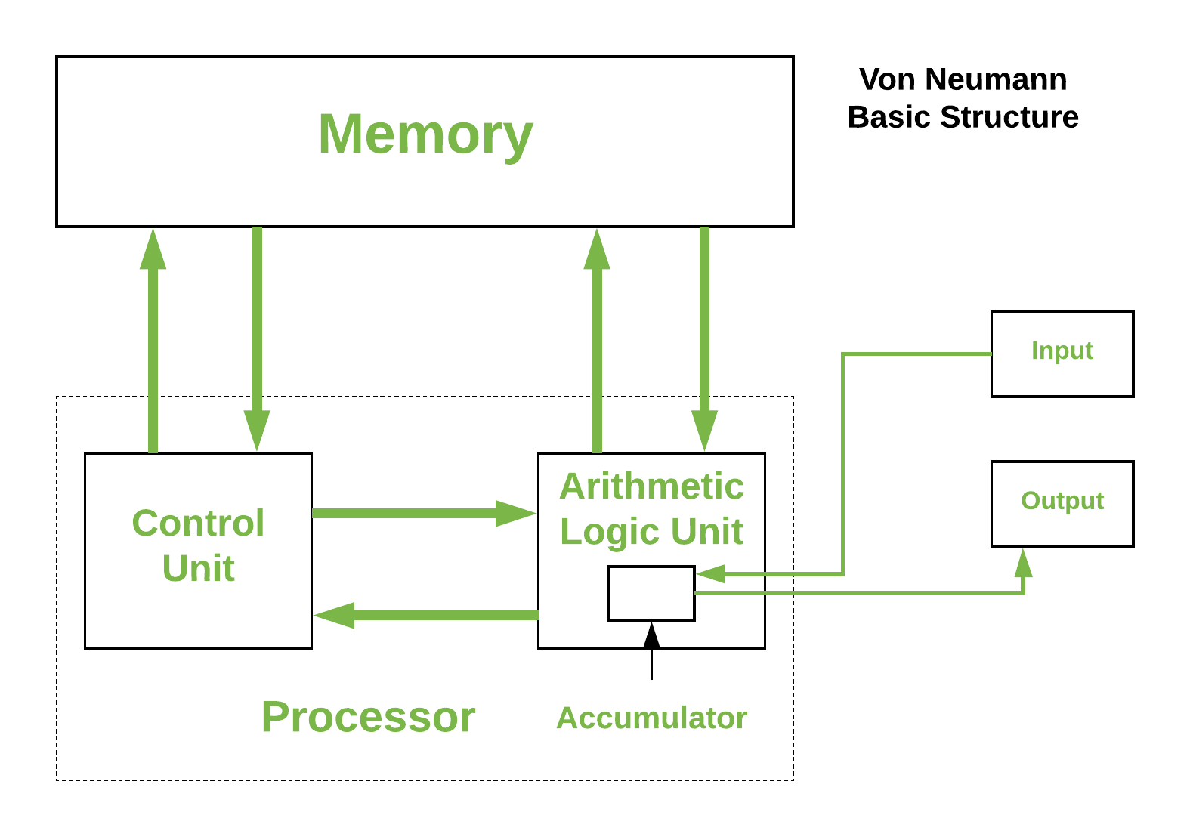
Input and Output Devices
Input devices allow data to be inputted into the system, while output devices allow for the result of computations to be extracted.

Slide 16
Von Neumann Architecture and Modern Computers
The concept of storing instructions in memory and processing them serially is a core feature of modern computers, and is a direct legacy of the Von Neumann Architecture
While influential, the Von Neumann Architecture does have limitations, including the 'Von Neumann bottleneck.' This bottleneck refers to the difficulty in boosting a machine's computational speed because the single data bus creates a constraint on the speed of data transfer.
Current computing architectures are exploring ways to overcome this bottleneck, with approaches like parallel computing and quantum computing.

Slide 17
Computer Types
Type | Description | Example
Supercomputers | Most powerful computers used for complex tasks and simulations | Sunway TaihuLight, IBM Summit
Mainframe Computers | Powerful machines used for bulk data processing and transactions | IBM's Z Series mainframes
Minicomputers | Medium-sized computers used for tasks requiring moderate power | PDP-11, IBM System/36
Microcomputers | Common personal computers used for personal and office tasks | Desktops, laptops, tablets, smartphones
Servers | Computers that manage network resources and provide network services | Web servers, mail servers, database servers
Embedded Systems | Computers integrated into other machines to control certain functions | ATMs, cars, appliances, digital watches

